Slide 1
Online Training (TSIRTS)
Training Needs Completed Prior to Reporting to Camp Atterbury
Emergency Preparedness Response Course:
jkodirect.jten.mil/html/COI.xhtml?course_prefix=DMRTI&course_number=-US026
Joint Staff Suicide Awareness and Prevention:
https://jkodirect.jten.mil/html/COI.xhtml?course_prefix=JS&course_number=-US006
Combating Trafficking in Persons: (General Awareness A)
https://jkodirect.jten.mil/html/COI.xhtml?course_prefix=CTIP&course_number=-GA-US011
SERE 100.2 (Code of Conduct):
https://jkodirect.jten.mil/Atlas2/page/coi/externalCourseAccess.jsf?v=1554302308095&course_prefix=J3T&course_number=A-US1329
Cyber Awareness and Mandatory Army IT User Agreement:
https://cs.signal.army.mil/
Intro to Biometrics:
https://www.tam.usace.army.mil/portals/53/docs/udc/training/biometrics%20101.pdf

Slide 2
Online Training (TSIRTS)
Training Needs Completed Prior to Reporting to Camp Atterbury
Insider Threat Awareness:
  https://securityawareness.dcsa.mil/itawareness/index.htm
Anti-Terrorism Awareness (Level 1):
  https://jkodirect.jten.mil/Atlas2/page/coi/externalCourseAccess.jsf?v=1554302084733&course_prefix=JS&course_number=-US007
Operational Security (OPSEC):
  https://securityawareness.dcsa.mil/opsec/index.htm
Derivative Classification:
  https://securityawareness.dcsa.mil/derivative/index.htm
DoD Controlled Unclassified Information Training:
  https://securityawareness.dcsa.mil/cui/story.html
DoD Annual Security Awareness Refresher:
  https://securityawareness.dcsa.mil/awarenessrefresher/index.html
The forms listed below will be sent to you by your DART Pre-Deployment POC:
1) Acknowledgement of Personnel Reporting
2) Instructions for Requesting Foreign Travel Reporting and Approval

Slide 3
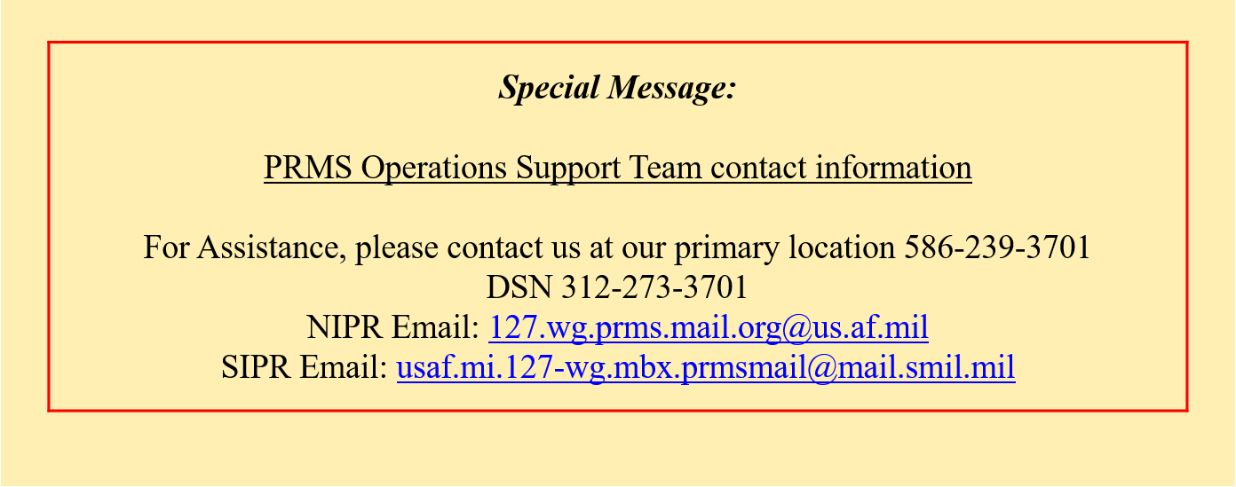
  ISO-PREP Certificate
**YOU MAY ACCESS FROM NIPR**
https://prmsglobal.prms.af.mil/
If you’ve completed ISO-PREP previously, contact with your local site security manager and request them to send us a memo or email validating that your ISO-PREP information is current.

Slide 4
Online Training (TSIRTS)
Any issues or questions with online training contact:
DLL-CETAD-DART_Admin@usace.army.mil

